Slide 1
Azure machine learning

Slide 2
Agenda
What problem do we want to solve 20mins
What can we do ? Traditional way / easy way 10mins
Azure machine learning is a tool for us to use 10 mins
How are we going to use it 30mins ()
Demo: How to modify the project to make into our use 20mins
Q&A

Slide 3

Machine Learning
What is big data?
What is machine learning?
Uses of machine learning.
Why machine learning?
Who uses it?

Slide 4
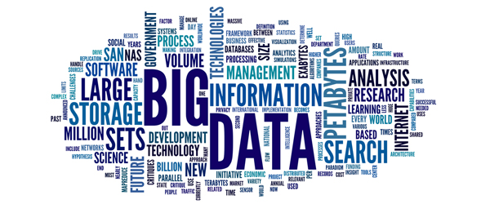
What is big data?
LARGE volumes of data
Structured
Unstructured
Collected from a variety of sources
Commercial transactions
Social media
Publicly available sources
Sensors
Business statistics
How to analyze this data?

Slide 5
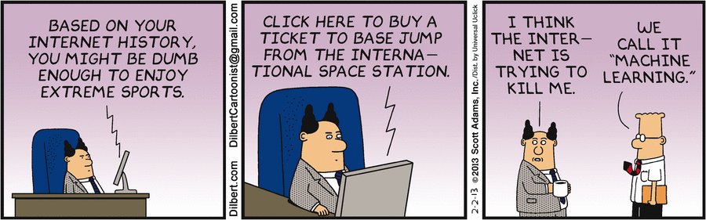
What is machine learning?
Examine LARGE amounts of data.
Find patterns. Build models.
Automatic improvement of the algorithms.
Iterative approach.
Multiple passes so the MACHINE LEARNS.
Predictions.

Slide 6

Uses of machine learning.
Classification.
Usually supervised.
E.g.: Spam filter.
Clustering.
Similar to classification but the groups aren’t known in advance (Unsupervised)
E.g.: Recognize communities in social networks.
Regression.
Estimate relationships among variables.
E.g.: Car technical specifications -> Market price
Etc..

Slide 7
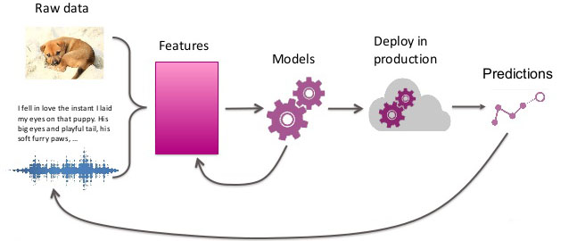
Why machine learning?
Growing volumes and varieties of available data.
Processing this data manually would be impossible.
Cheaper computational processing and storage.
Competitive advantage.
Companies can get huge advantages by analyzing data from the markets.

Slide 8

Who uses it?
Financial institutions
E.g.: Avoiding fraud.
Governments
Government agencies have several sources of data that can be analyzed to increase his efficiency.
Medicine and science
E.g.: Dna sequencing, patients wearable sensors.
Marketing and sales
Predict market and/or consumer behaviors.
Transportation
Make more efficient routes and schedules.

Slide 9
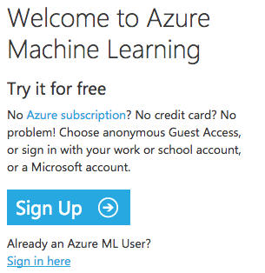
Microsoft Azure Machine Learning Studio
Go to Microsoft Azure Machine Learning Studio.
In order to use the framework we need a Microsoft account:
I already have one of them (eg. Hotmail) → just “Sign in”
I do not have any of them → must “Sign Up”

Slide 10
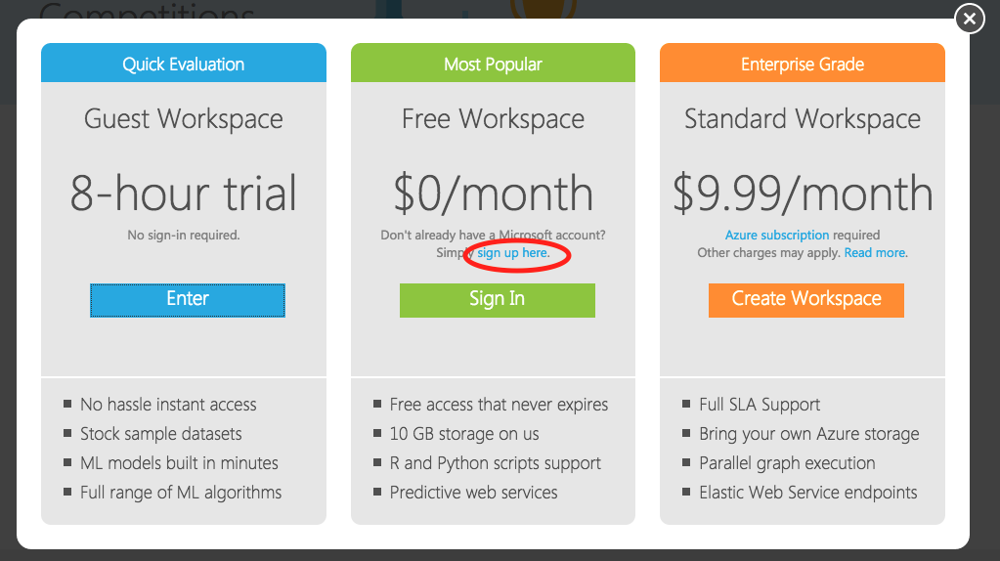
Sign up
Select “Free Workspace”
Free access
10GB Storage
R and Python scripts support
Predictive web services

Slide 11
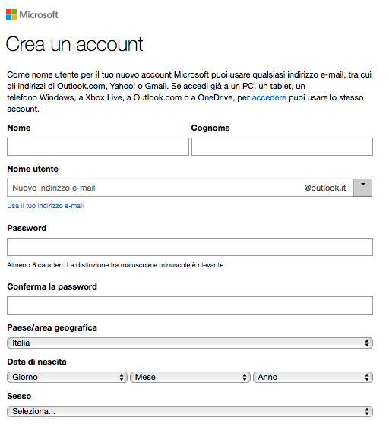
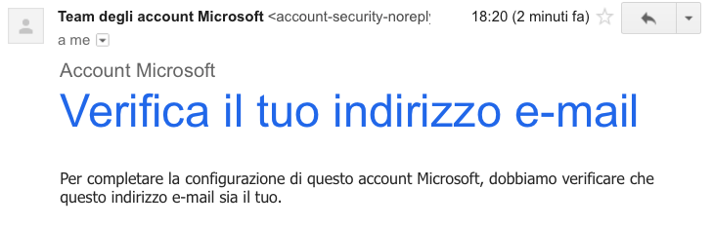
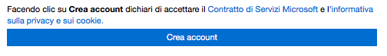
Create an account
Fill the form
Click on create an account
Verify your email

Slide 12
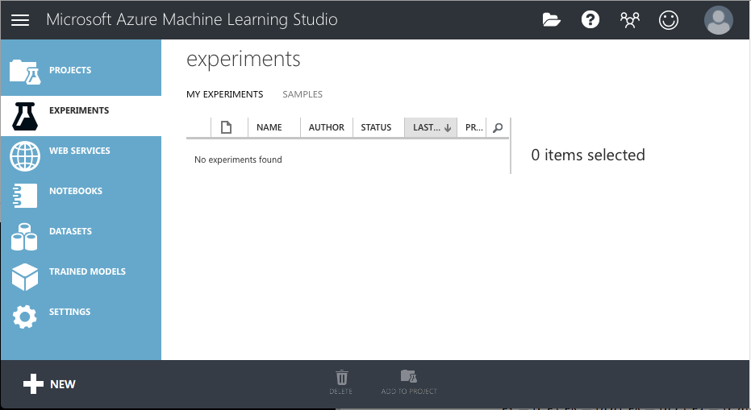
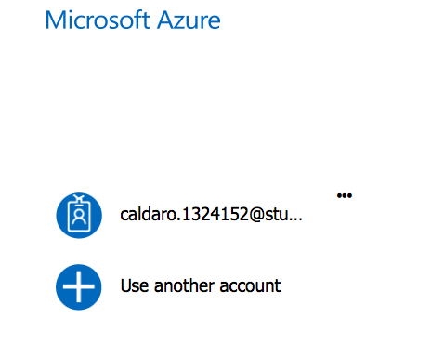
Sign in
Type the account you want to use and log in in the free workspace.

Slide 13
Five steps to create an experiment
Create a model
Get data
Prepare the data
Define features
Train the model
Choose and apply a learning algorithm
Score and test the model
Predict new automobile prices

Slide 14
Automobile price prediction
Technical Specifications
Market Price

Slide 15
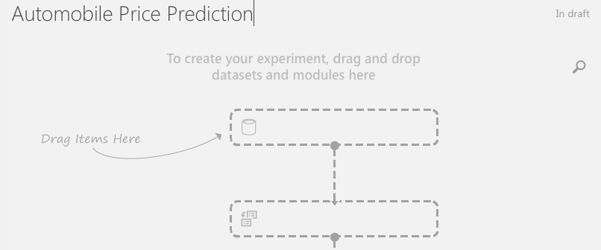
Create a blank experiment
→

Slide 16
1. Get Data
Use data in the existing sample datasets
Create your own dataset by NEW dataset
Import data: Load data from sources such as the Web, Azure SQL database, Azure table, Hive table, or Windows Azure BLOB storage. Formerly known as Reader

Slide 17
Using Azure saved dataset
In the search bar, look for automobile
Drag and drop the dataset in the dashboard
→

Slide 18
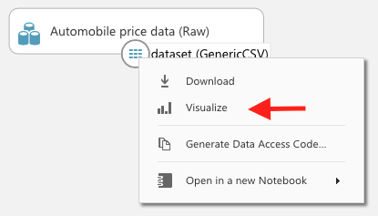
Visualize the Data
Selecting one column, some statistics are shown
Given the variables for a specific automobile, we're going to try to predict the price (last column)

Slide 19
2. Prepare the data
This menu can be used to transform raw data to the input of the next modules

Slide 20
Preprocess automobile dataset
Clean missing values present in the columns of various rows so the model can analyze the data correctly.
Do not consider some columns.
→

Slide 21
Clean missing data: remove column
Click on Launch column selector
On the left, click With rules
Under Begin With, click All columns.
Select Exclude and column names,
Click inside the text box and select normalized-losses

Slide 22
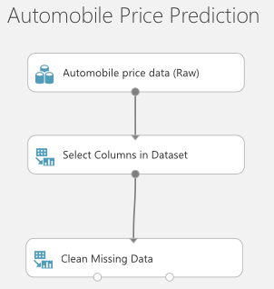
Clean missing data: remove row
→
→

Slide 23
Run the experiment and visualize processed data
Save the experiment
Run it
Visualize data output from Clean Missing Data
Check differences

Slide 24
3. Define features
Features: individual measurable properties of something you’re interested in.
Finding a good set of features for creating a predictive model requires experimentation and knowledge about the problem you want to solve.
(In our example each row represents one automobile, and each column is a feature of that automobile)

Slide 25
Feature selection
As before, drag Select columns in Dataset
Connect Clean Missing Data to the module just added
Click on Launch column selector
On the left, click With rules
Under Begin With, click No columns.
Select Include and column names,
Click inside the text box and select “make”, “body-style”, “wheel-base”, “engine-size”, “horsepower”, “peak-rpm”, “highway-mpg”, “price”

Slide 26
4. Choose and apply a learning algorithm
Classification: predicts an answer from a defined set of categories
Regression: predicts a number.
(Because we want to predict price, which is a number, we'll use a regression algorithm)
Build predictive model
Train
Test

Slide 27
Split data into train set and test set
→
→

Slide 28
Learning algorithm selection
Connect the "Train Model" module to both the "Linear Regression" and "Split Data" modules
+
=

Slide 29
Train a specific feature
Click the Train Model module
Click Launch column selector in the Properties pane
Click By Name
Select the price column.
This is the value that our model is going to predict.

Slide 30
5. Predict new automobile prices
75 percent of our data used to train the model using
25 percent of the data to score the model functions.

Slide 31
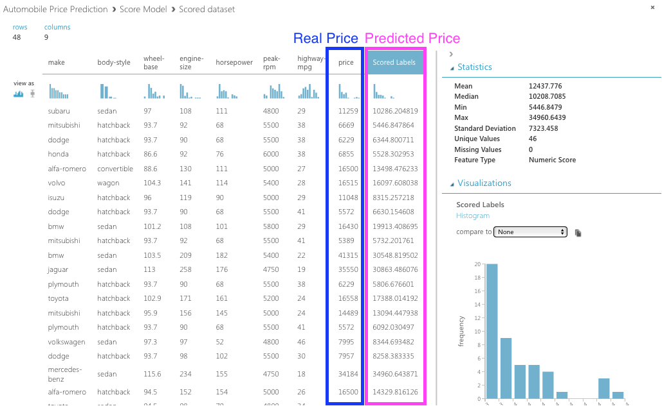
Output of the score module
Predicted values for price and its probability.

Slide 32
Results evaluation
(Final Experiment)

Slide 33
Metrics
Mean Absolute Error (MAE): The average of absolute errors (an error is the difference between the predicted value and the actual value).
Root Mean Squared Error (RMSE): The square root of the average of squared errors of predictions made on the test dataset.
Relative Absolute Error: The average of absolute errors relative to the absolute difference between actual values and the average of all actual values.
Relative Squared Error: The average of squared errors relative to the squared difference between the actual values and the average of all actual values.
Coefficient of Determination: Also known as the R squared value, this is a statistical metric indicating how well a model fits the data.

Slide 34
How a metric should be
For each of the error statistics, smaller is better.
A smaller value indicates that the predictions more closely match the actual values.
For Coefficient of Determination, the closer its value is to one (1.0), the better the predictions.

Slide 35
Iterate to improve the model
Change the features you use in your prediction
Modify the properties of the Linear Regression algorithm
Try a different algorithm altogether
Add multiple machine learning algorithms to your experiment at one time
Compare two of them by using the Evaluate Model module

Slide 36
Deploy the model as a predictive web service
Satisfied with your model???
You can deploy it as a web service!
Use the WebService to predict automobile prices by using new data…

Slide 37
6. Deploy an Azure Machine Learning web service
Create a training experiment
Convert the training experiment to a predictive experiment
Deploy the predictive experiment as a New web service

Slide 38
Convert the training experiment to a predictive experiment
By converting to a predictive experiment, you're getting your trained model ready to be deployed as a scoring web service.
Users of the web service can send input data to your model and your model will send back the prediction results.
As you convert to a predictive experiment, keep in mind how you expect your model to be used by others.

Slide 39
Predictive experiment

Slide 40
Deploy the predictive experiment as a New web service
Click Run
Click Deploy Web Service
Select Deploy Web Service New.
The deployment page of the Machine Learning Web Service portal opens.

Slide 41
Test your Web Service with a Python Program
request/response page contains Request Response API Documentation, with a starter Python program (that must be modified) to call the web service

